Slide 1
EPEAT Scheme Scheme Owner: The Green Electronics Council Program Manager: Pam Seaver

Slide 2
What is EPEAT?
“Electronic Products Environmental Assessment Tool”
An environmental procurement tool designed to help institutional purchasers and consumers evaluate, compare and select electronics products based on their environmental attributes.
The EPEAT Program was developed through the collaboration of stakeholders from the business, advocacy, government and academic institutions. The program is managed by the Green Electronics Council (GEC)

Slide 3
Background
Milestones
2001 EPA awarded a grant to develop an electronics environmental rating system.
2002 Stakeholders begin developing rating system for electronics.
2005 Stakeholders select host to implement IEEE 1680. EPA provides start‐up grant. EPEAT Inc. formed.
2006 IEEE 1680.1 released, www.epeat.net launched. Maintained by Green Electronics Council (GEC)
2012 IEEE 1680.2, 1680.3 standards released.
2013 IEEE 1680.2, 1680.3 registry launch!

Slide 4
Acronyms
PRE – Product Registration Entity (UL Environment)
MSE – Market Surveillance Entity (Green Electronics Council)
PVC – Product Verification Committee
The PVC is a committee made up of 5 independent members with technical expertise and knowledge of electronics, hazardous materials, regulations, environmental issues, etc.
QV – Qualified Verifier
Conducts the investigation for the Verification Round and makes the recommendation to the PVC for conformance or non-conformance of the product. ULE has 7 trained Qualified Verifiers.

Slide 5
Main Scheme Documents - EPEAT
EPEAT to require ISO 17020 or 17065 accreditation by an IAF member accreditation body beginning January 1, 2016. We are following ISO 17020.
GEC/EPEAT Documents:
EPEAT Program Guidelines
EPEAT Product Registration System
EPEAT PRE Agreement
EPEAT Requirements of PREs
ULE Documents:
EPEAT Service Terms
00-EN-P0859 - ULE 17020 Compliance Manual for EPEAT
00-EN-S0857 - EPEAT Desk Review Process
00-EN-S0858 - EPEAT Verification Round Process

Slide 6
IEEE 1680 Family of Standards
Current:
IEEE 1680 umbrella standard – “rules of the game”, definitions
IEEE 1680.1 environmental criteria for computers & displays
IEEE 1680.2 environmental criteria for imaging equipment
IEEE 1680.3 environmental criteria for TVs
Planning:
UL 110
IEEE 1680.1 update
IEEE 1680.4 environmental criteria for servers

Slide 7
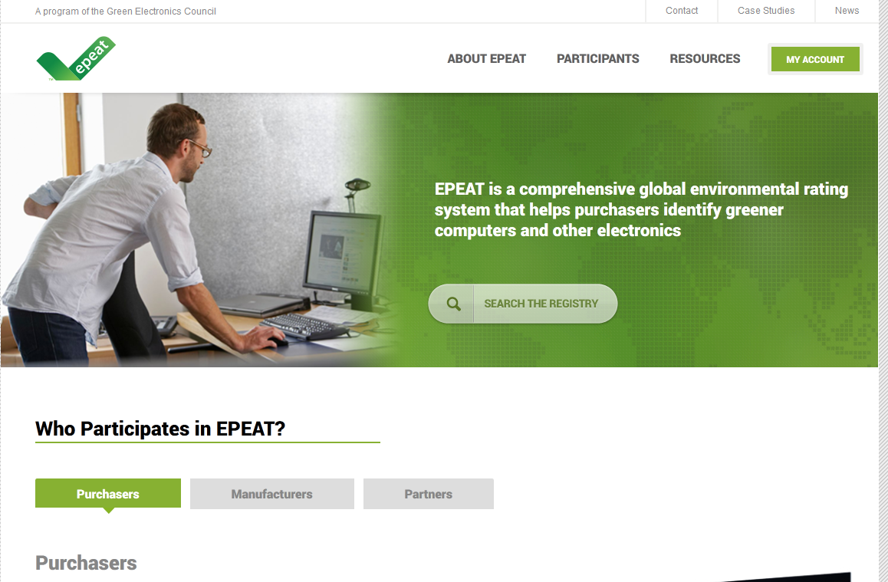
www.epeat.net

Slide 8
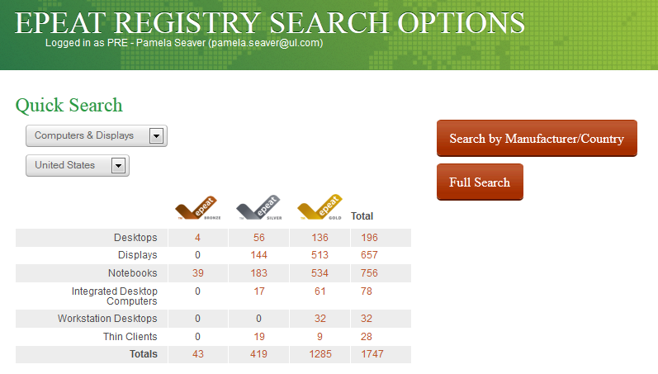
Product Listings

Slide 9
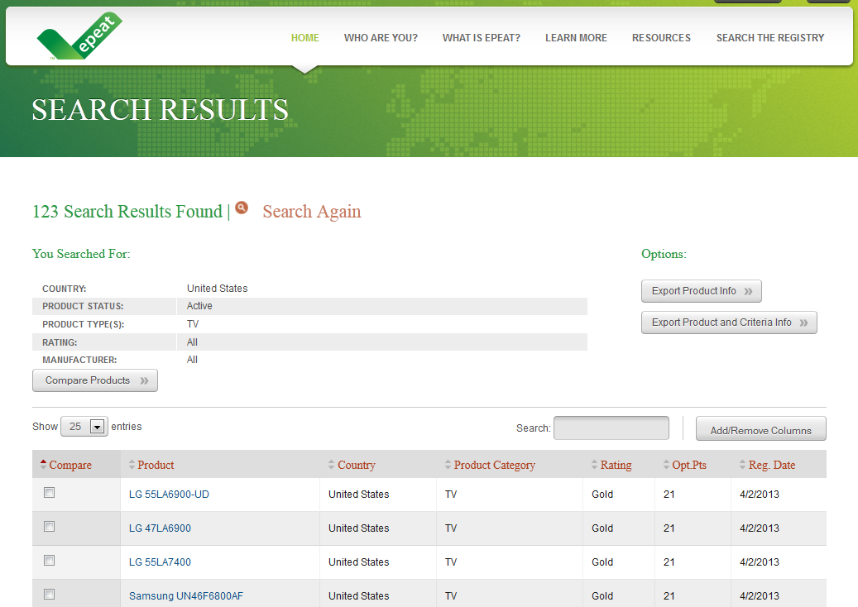

Slide 10
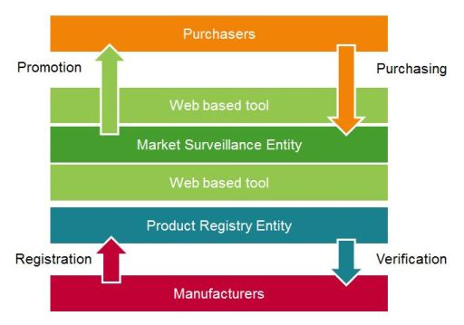
EPEAT Overview
Manufacturers approach PRE to declare their products’ conformance
Product Registration Entity (PRE) performs a Desk Review of the accuracy of the manufacturer’s declarations, activates products on the registry. After sufficient desk reviews have been completed, Manufacturer is given access to self-declare product conformance
Start

Slide 11
EPEAT Overview (continued)
EPEAT Product Verification Committee (PVC) approves the Verification Round Plan for 1680.1, 1680.2 or 1680.3. Goal is 6 Verification Rounds per year, per standard. Select specific criteria, select countries.
Verification Rounds may be:
Level 0: Independent document review – no subscriber involvement required
Level 1: Desk inspection of evidence (document review)
Level 2: Empirical investigations/interviews (analytical test data requested)
Level 3: Analytical investigation (testing performed by PRE)
PRE conducts verification/investigations by communicating with the Subscriber to obtain sufficient data to prove conformance. Investigation reports are submitted to the EPEAT PVC with a recommendation that the product is conformant or non-conformant.
PVC reviews the investigation reports, determines Conformance/Non-conformance (may agree or disagree with the QV)
MSE Publishes Investigation Results. When a non-conformity is found, manufacturer must take corrective action.

Slide 12
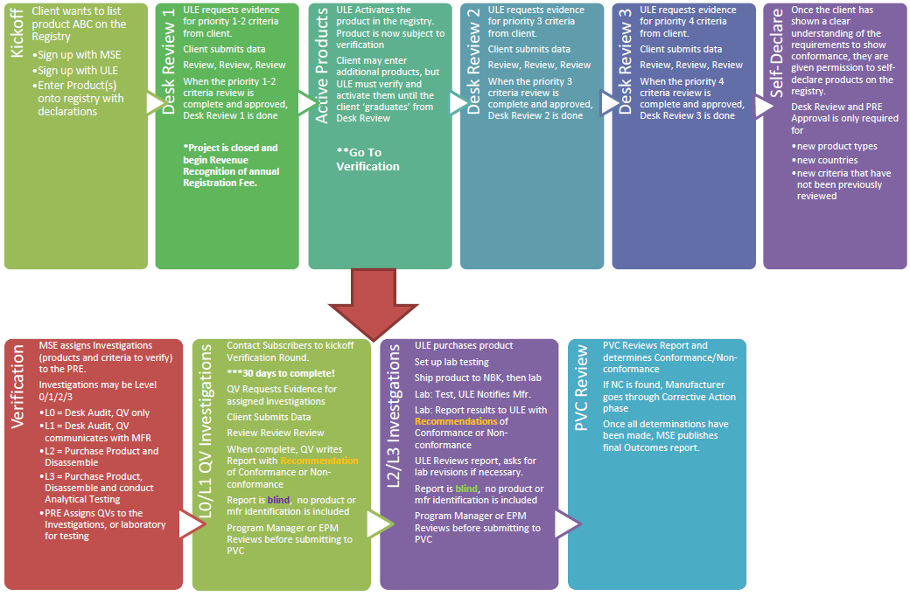
EPEAT Process

Slide 13
Deliverables
Desk Review Deliverables
Completion Email
Desk Review Workbook
Verification Round Deliverables
Investigation Report

Slide 14
EPEAT Registration vs. ULE SPC
EPEAT
Self-declaration by manufacturers and post-market surveillance system
Required in purchasing specs for:
national governments
large enterprises
state/provincial/county/municipal governments
universities, K-12 schools
EPEAT market recognition for environmentally preferable electronic products
Desk Review for initial registration, brief and do not check all criteria for all products
Verification Rounds – Goal is 6 per year, per standard, only some criteria reviewed and only ~10% of products are verified each round
SPC
Third party certification, pre-market evaluation
Voluntary certification
UL brand market recognition
Certification includes comprehensive review of all criteria, visual inspection and on-site audit
Annual Review is required, all models/families once per year

Slide 15
Competency and Records
Competency:
Personnel involved in the EPEAT Scheme are to become Qualified Verifiers (QVs), a training provided by the GEC.
EPMs perform Desk Reviews.
ULE uses FUS QVs and EPMs to perform Verifications Rounds.
Records:
Desk Review Workbook
Manufacturer Desk Review Status on EPEAT.net
Investigation Report

Slide 16


